Slide 1


Winforms
WPF
Speaker:
Igor

Slide 2

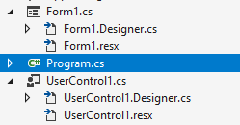

Window Forms
Windows Forms (WinForms) is a graphical (GUI) class library included as a part of Microsoft .NET Framework, providing a platform to write rich client applications for desktop, laptop, and tablet PCs
Two types of item:
Form
Control

Slide 3
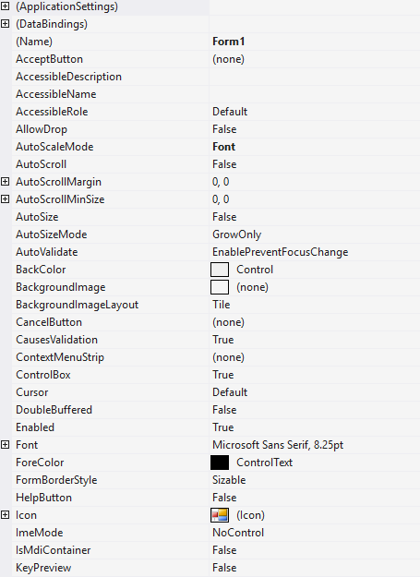
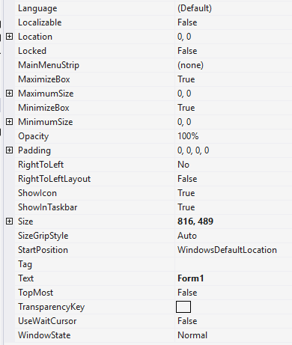
Form Properties
Controls
ClientRectangle

Slide 4
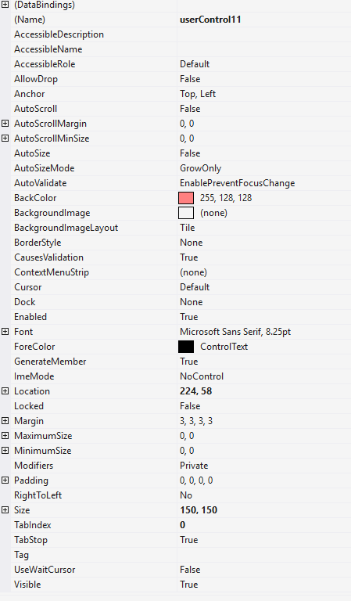
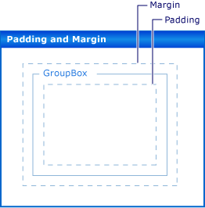
UserControl Properties

Slide 5
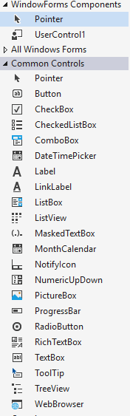
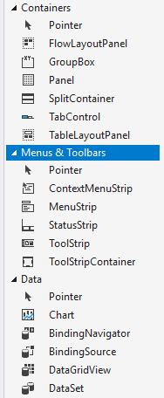
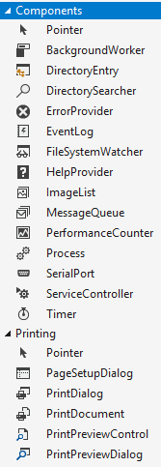
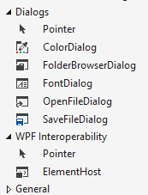
Main Controls

Slide 6

WPF
Windows Presentation Foundation (WPF) is a UI framework that creates desktop client applications. The WPF development platform supports a broad set of application development features, including an application model, resources, controls, graphics, layout, data binding, documents, and security.

Slide 7
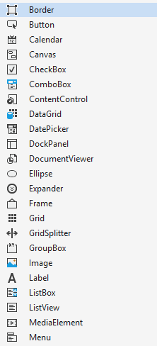
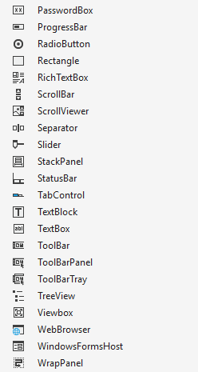
Main Controls

Slide 8
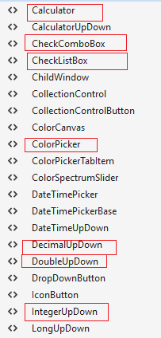

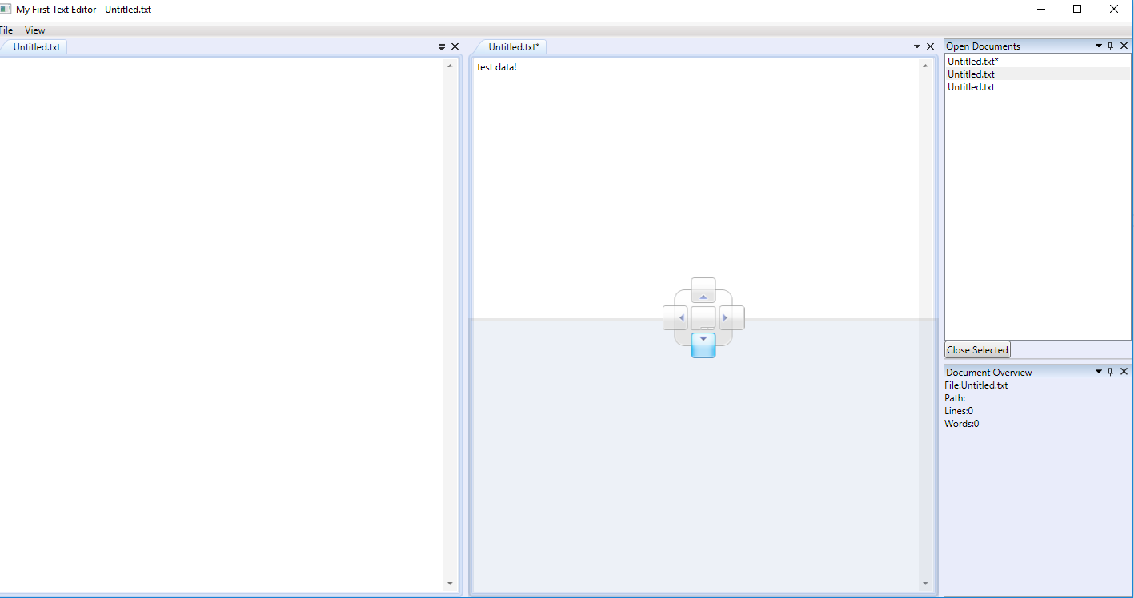
Extended

Slide 9
WPF Panels
Canvas
WrapPanel
StackPanel
DockPanel
Grid
UniformGrid

Slide 10
Canvas
A simple panel, which mimics the WinForms way of doing things. It allows you to assign specific coordinates to each of the child controls, giving you total control of the layout. This is not very flexible though, because you have to manually move the child controls around and make sure that they align the way you want them to. Use it (only) when you want complete control of the child control positions.
WrapPanel
The WrapPanel will position each of its child controls next to the other, horizontally (default) or vertically, until there is no more room, where it will wrap to the next line and then continue. Use it when you want a vertical or horizontal list controls that automatically wraps when there's no more room.
StackPanel
The StackPanel acts much like the WrapPanel, but instead of wrapping if the child controls take up too much room, it simply expands itself, if possible. Just like with the WrapPanel, the orientation can be either horizontal or vertical, but instead of adjusting the width or height of the child controls based on the largest item, each item is stretched to take up the full width or height. Use the StackPanel when you want a list of controls that takes up all the available room, without wrapping.

Slide 11
DockPanel
The DockPanel allows you to dock the child controls to the top, bottom, left or right. By default, the last control, if not given a specific dock position, will fill the remaining space. You can achieve the same with the Grid panel, but for the simpler situations, the DockPanel will be easier to use. Use the DockPanel whenever you need to dock one or several controls to one of the sides, like for dividing up the window into specific areas.
Grid
The Grid is probably the most complex of the panel types. A Grid can contain multiple rows and columns. You define a height for each of the rows and a width for each of the columns, in either an absolute amount of pixels, in a percentage of the available space or as auto, where the row or column will automatically adjust its size depending on the content. Use the Grid when the other panels doesn't do the job, e.g. when you need multiple columns and often in combination with the other panels.
UniformGrid
The UniformGrid is just like the Grid, with the possibility of multiple rows and columns, but with one important difference: All rows and columns will have the same size! Use this when you need the Grid behavior without the need to specify different sizes for the rows and columns.

Slide 12
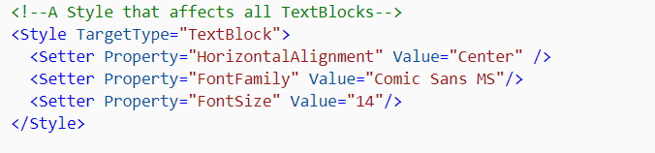
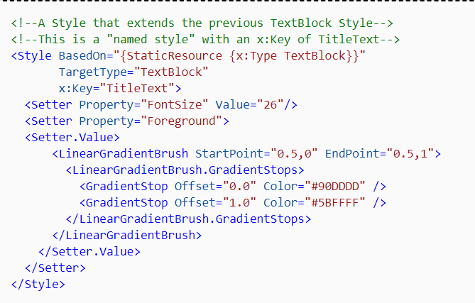
Style
Style is a convenient way to apply a set of property values to more than one element.

Slide 13
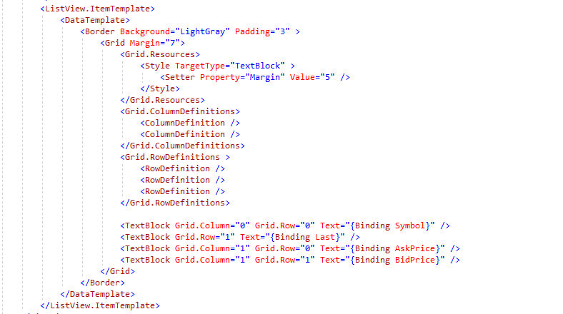
Data Templates

Slide 14
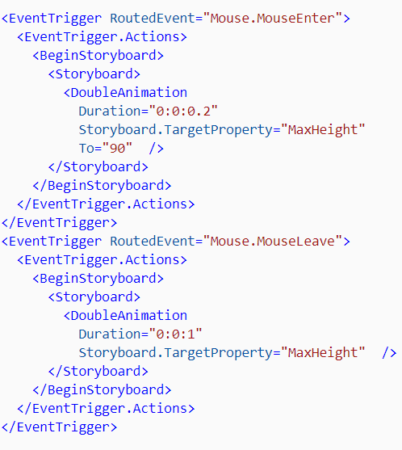
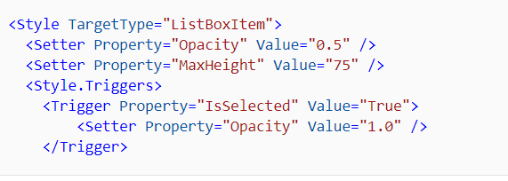
Triggers
A trigger sets properties or starts actions, such as an animation, when a property value changes or when an event is raised
Event Triggers
Property Triggers

Slide 15
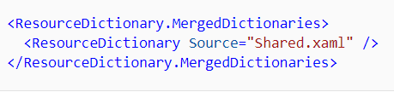
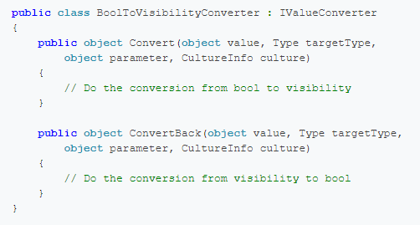
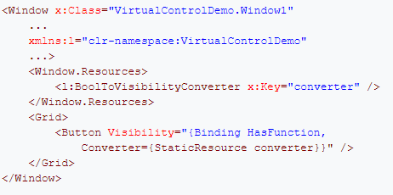
To share a set of resources, including styles and templates, across applications, you can create a XAML file and define a ResourceDictionary.
Value Converter

Slide 16

Thank you!

